Slide 1
Analyzing Nintendo Video Game Sales

Slide 2
Table Of Content
1.Questions
2.Approach
3. Q1
4. Q2
5. Q3
6. Findings

Slide 3
Questions
What are the top 10 best selling games?
What are the top 5 best selling genres?
Which developers have the biggest sum of video game copies sold?

Slide 4
Approach
Data Scraped from Wikipedia page
Cleaned dataset through Excel and reformatted in order to answer questions.
Uploaded data to PowerBi to transform and visualize data.

Slide 5
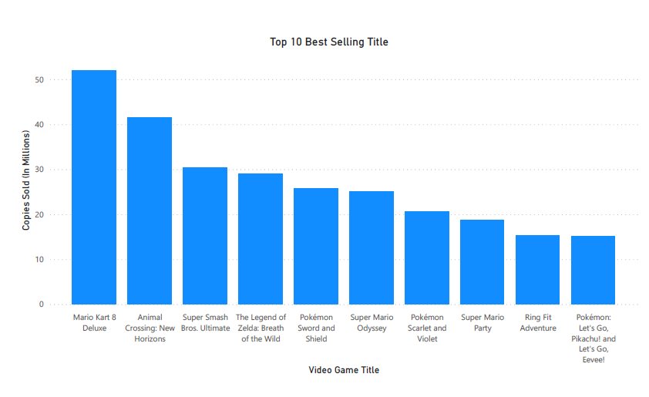
Top Selling Video Game
Here are the top 10 best selling video games with the top 7 breaking over 20 million copies. 8 out of 10 of the video games in the top 10 were all released pre 2020 with only two games being released after. Another interesting insight is 5 of these games are made by Nintendo EPD and 3 of them are made by Game Freak.

Slide 6
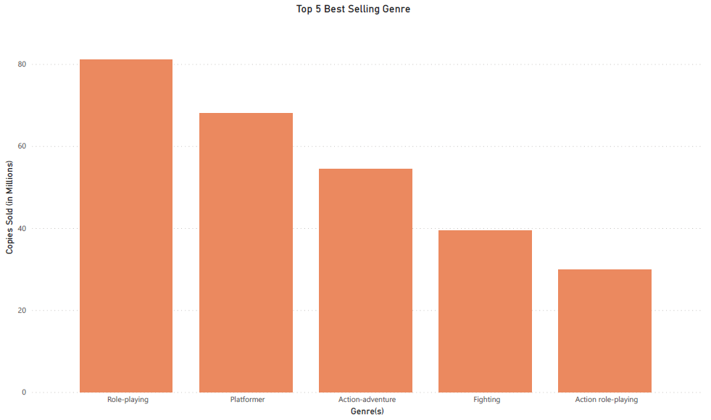
Top Selling Genre
Role-playing is the top genre with the very top games being Pokemon games. Platformer are the next selling genre with the top games being Mario platformers. The action-adventure genre had a mix but had majority of Legend of Zelda games. Fighting games had Super smash bros Ultimate.

Slide 7
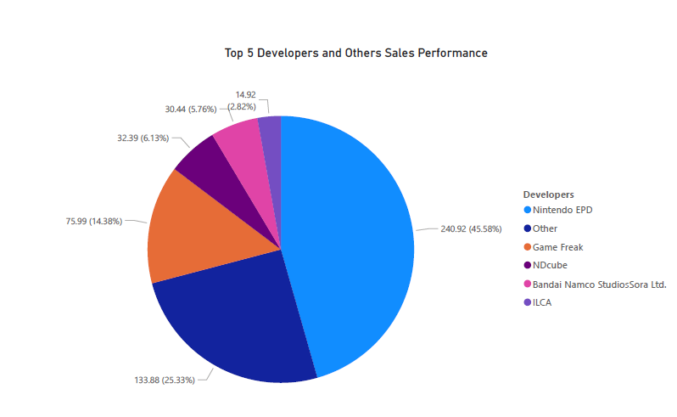
Video game Developers Sales
Nintendo EPD makes the majority of games sales with Game Freak being second. Afterwards there is a big drop with NDcube and Bandai Namco being 6 and 5 respectively. All the other developers individually only made up around 0.1% to 1% and were thus combined into the other category.

Slide 8
Applications of Data and Where We can Go
Role-Playing, platformer and action-adventure games seem to be the most popular genre thus a reasonable insight would be to focus on games in that genre. More data should be gathered from competitors like Sony and Microsoft to see if that trend is also there.
The 9 of the top 10 video games are established series or IPs with only ringfit being the exception. Nintendo can continue to make video games with these established series or IPs.
I would like to obtain time data to see which games sold the fastest on release. Based on the data we have now I predict the games that have a recent release date on this list most likely sold a lot on the first week.

